Slide 1
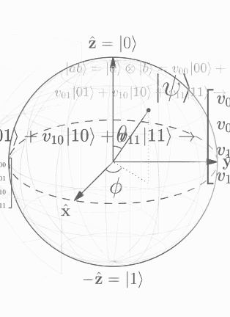





About Me
Nathan
Pacey
linkedin.com/in/nathan-pacey
npacey01.wixsite.com/website
github.com/NathanPaceydev
youtube.com/@nathanpacey

Slide 2




Education
M.Sc. Quantum Science and Engineering
Specialization in Quantum Information and Computation
Research interests in Quantum Surface Codes, QML, QEC, Quantum Algorithms and Fundamental Quantum Theory
B.A.Sc Engineering
Physics and Computing
Stockdale, P. Excellence Award in Physics
Thesis on Developing Machine Learning Algorithms for American Style Stock Options
Capstone on Development of a Web Application for Automated Clean Energy Feasibility Studies Using Global Data Sources

Slide 3









Industry Experience
Research Experience

Slide 4



Optomechanical Pair-Coherent State Generation
Schrodinger’s Optomechanical Cats: Pairing up for Quantum Computing
Nathaniel James Pacey
Supervising Professor Bradley Hauer
University of Waterloo Electrical and Computer Engineering
and Institute for Quantum Computing

Slide 5
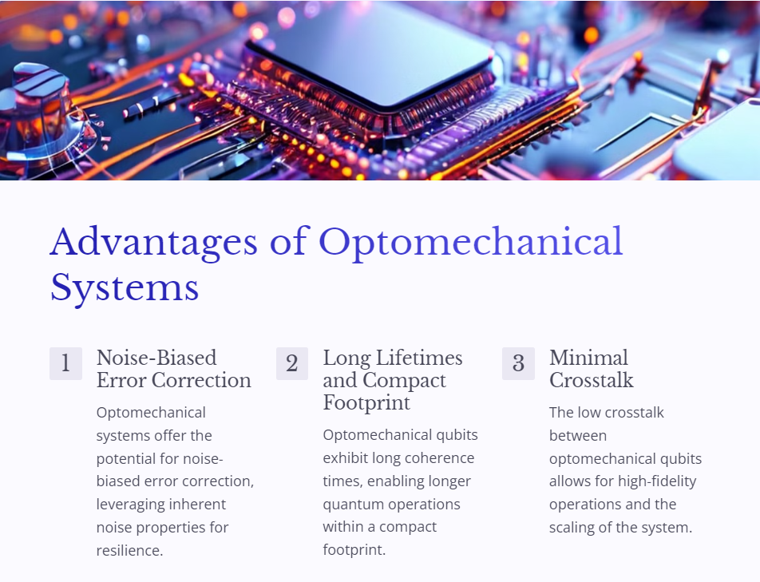
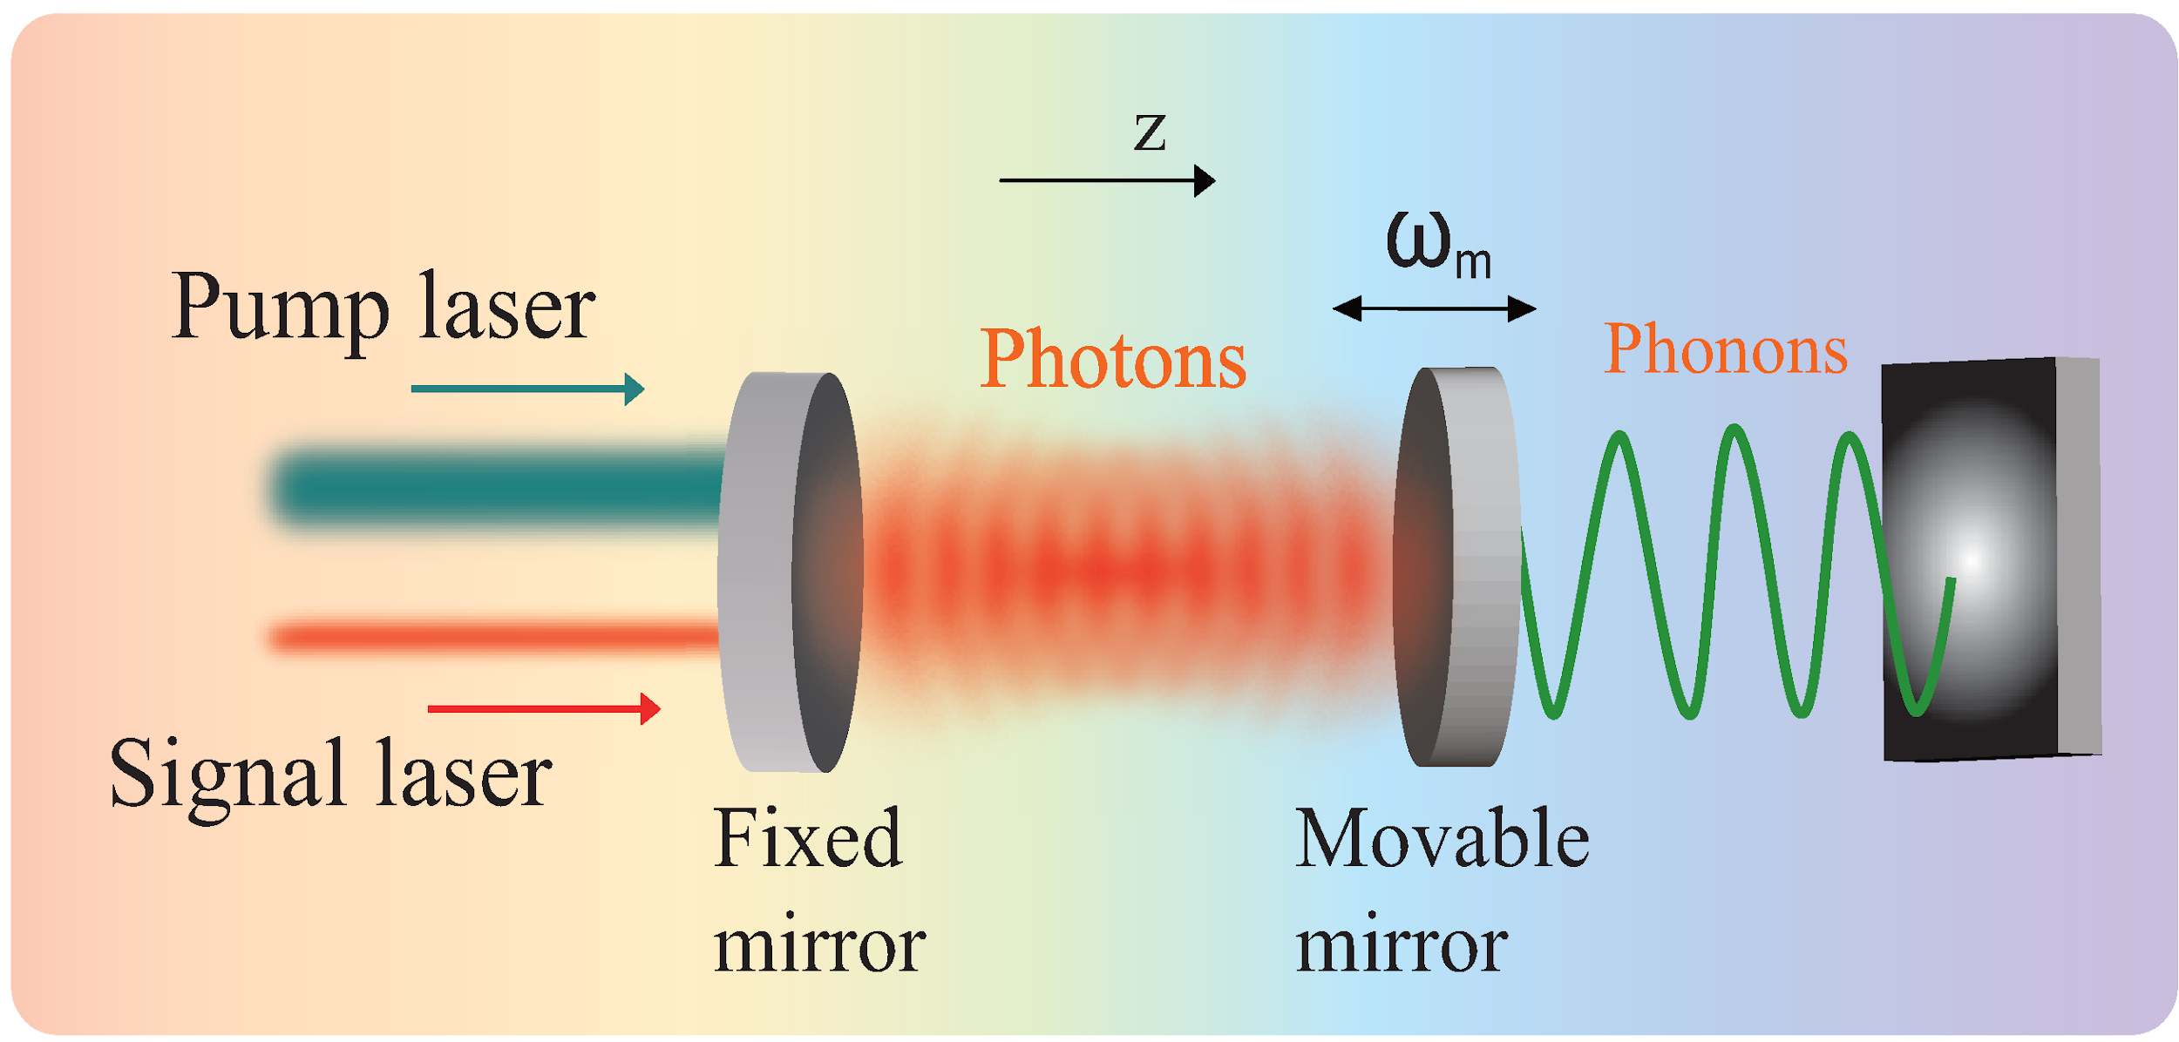

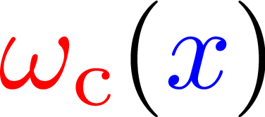
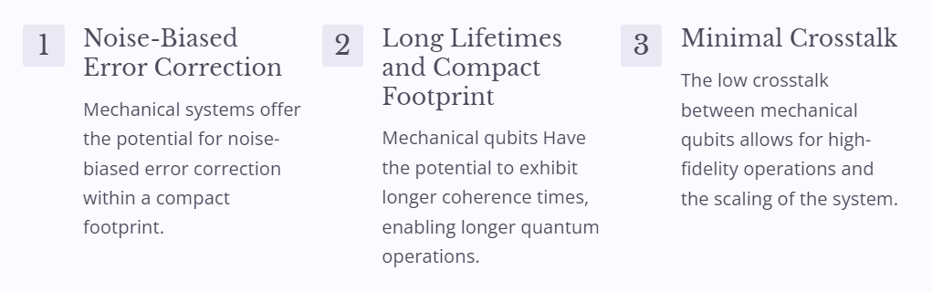

Li, Jinjin, et al. Entropy, vol. 15, no. 2, 2013, pp. 434-444
Advantages of Mechanical Systems
5
Notes:
Diagram Explanation:
Optomechanical Resonator:
Function: This diagram shows an optomechanical resonator, which consists of optical and mechanical components working together.
Pump Laser & Signal Laser:
Role: The pump laser and signal laser provide the necessary energy to the system. The pump laser drives the system, while the signal laser interacts with the cavity.
Fixed & Movable Mirrors:
Interaction: The fixed mirror and movable mirror create an optical cavity. The movable mirror can oscillate, allowing it to couple with phonons (mechanical vibrations).
Photons & Phonons Interaction:
Coupling: Photons (light particles) from the lasers interact with phonons (sound particles) in the movable mirror.
Frequency Induction: This interaction induces a frequency in the cavity, with photons and phonons coupling together. This coupling is key to the system's ability to correct noise-biased errors, maintain long coherence times, and reduce crosstalk.
Overall Mechanism:
Optomechanical Effects: The combination of optical and mechanical components allows the resonator to manipulate and control quantum states effectively, leveraging the advantages of mechanical systems for quantum computing.
Advantages of Mechanical Systems:
1. Noise-Biased Error Correction:
Explanation: Mechanical systems can correct errors caused by noise, improving reliability.
Benefit: This is achieved within a compact footprint, making it efficient for quantum systems.
2. Long Lifetimes and Compact Footprint:
Explanation: Mechanical qubits can maintain coherence for longer periods.
Benefit: Longer coherence times enable extended quantum operations, enhancing system performance.
3. Minimal Crosstalk:
Explanation: Mechanical qubits experience low crosstalk, meaning they don’t interfere much with each other.
Benefit: This allows for high-fidelity operations and easier scaling of the quantum system.
Quantum companies are already researching mechanical quantum systems

Slide 6

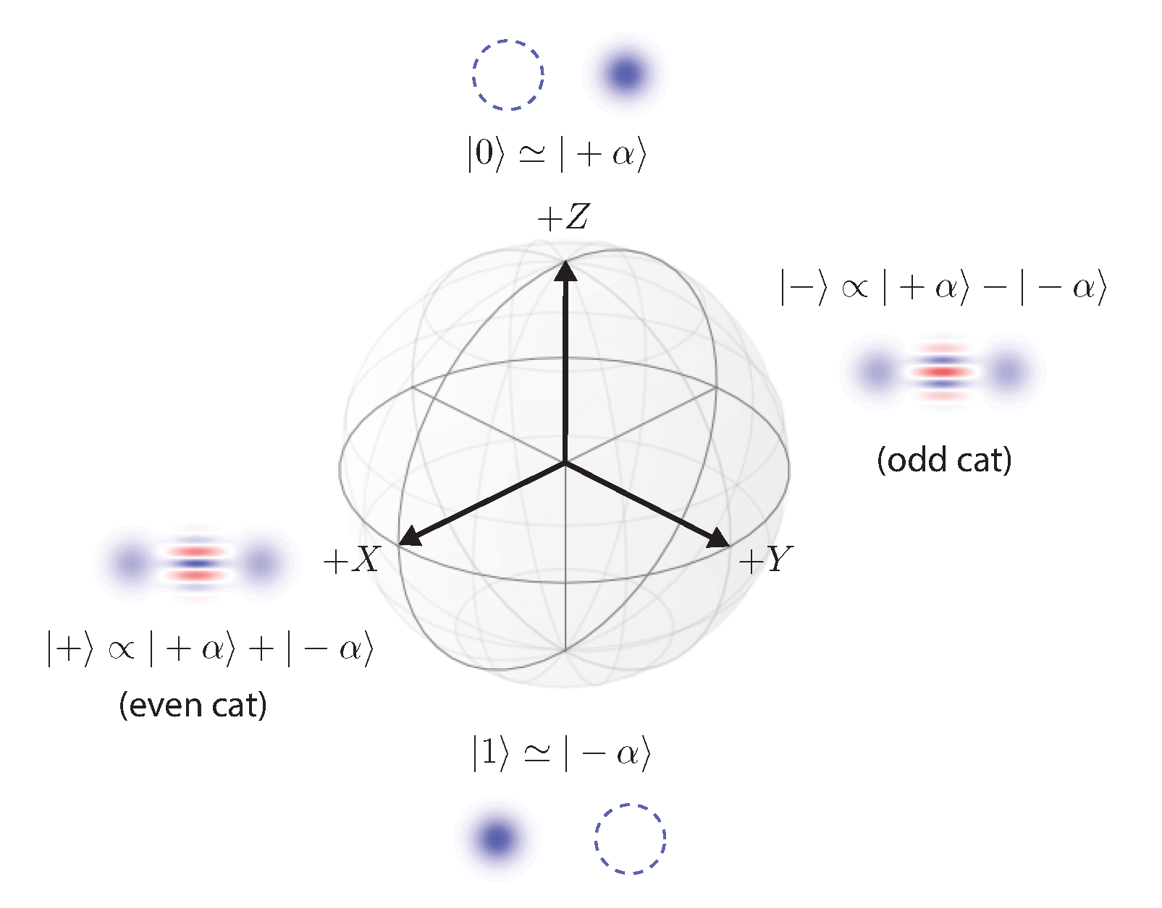
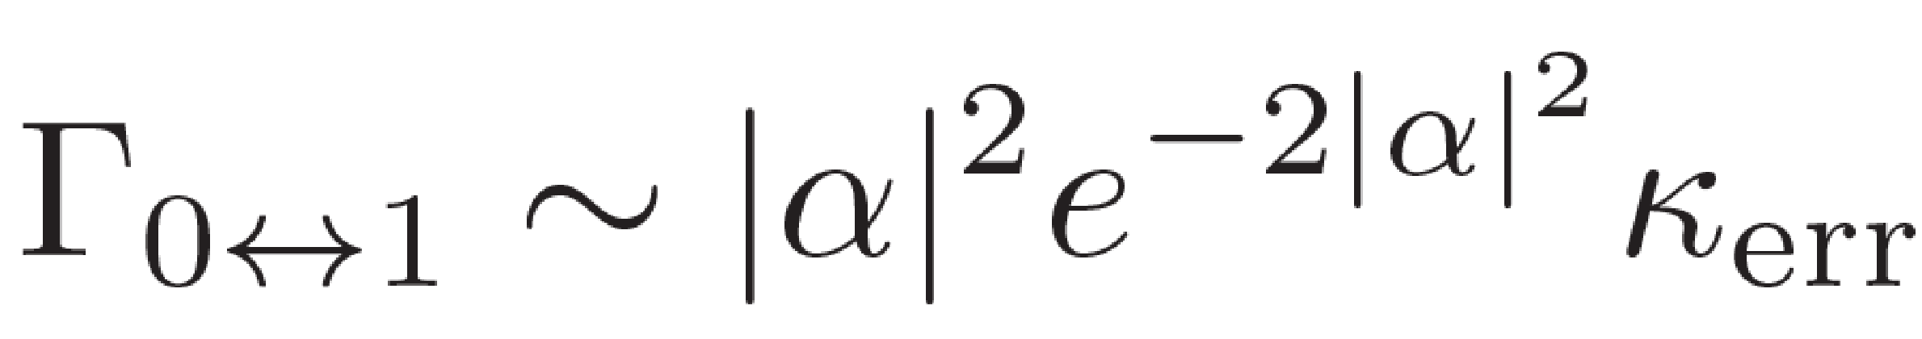
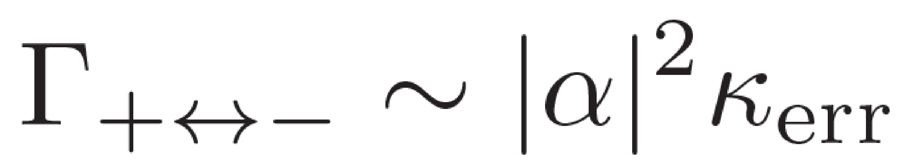
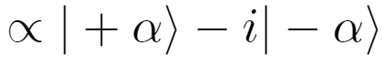
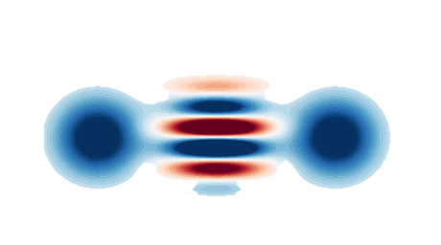
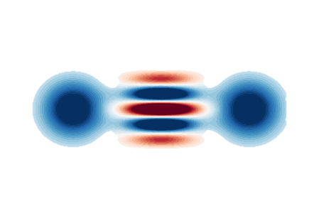
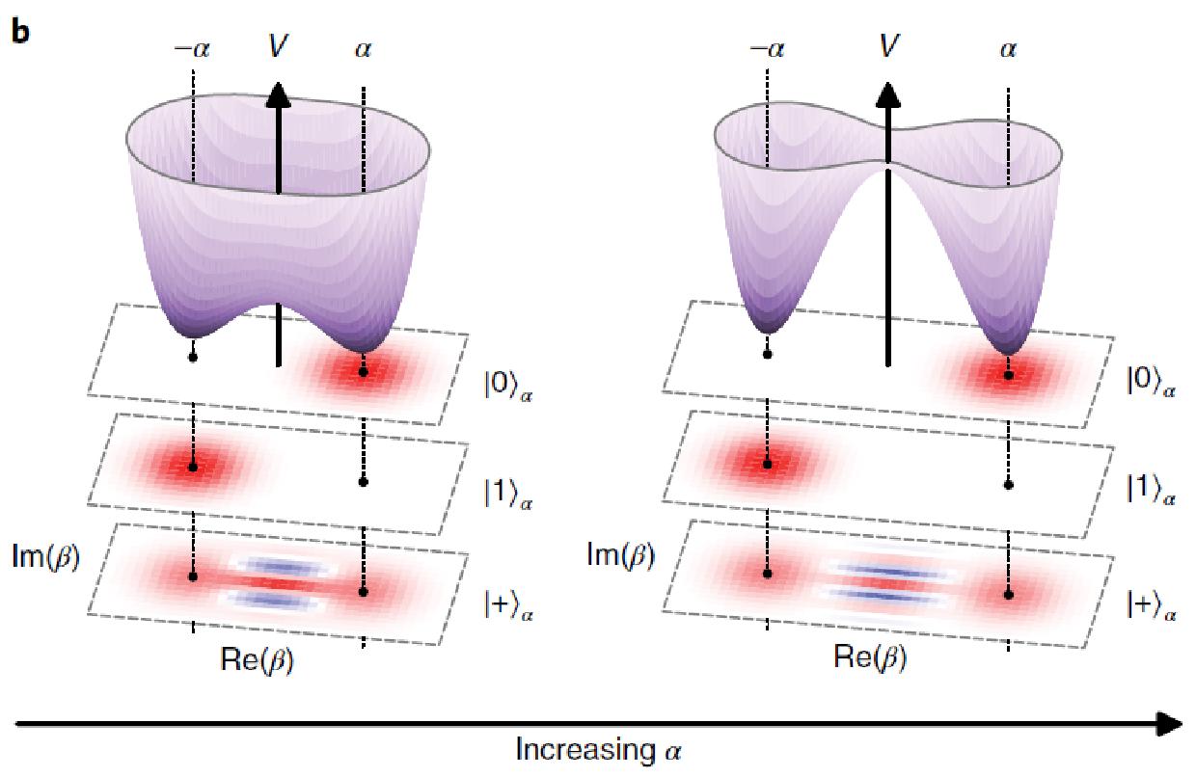
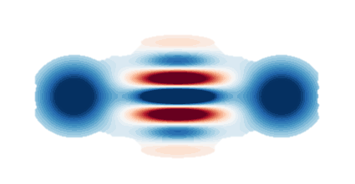
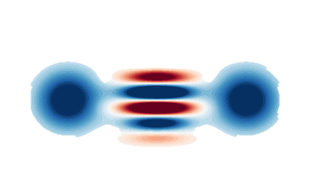
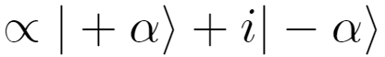
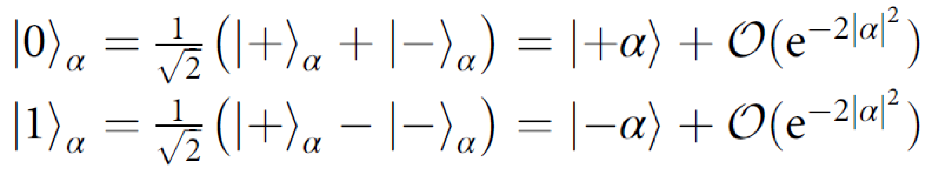
Cat Codes
Bit-flip error rate
Phase-flip error rate
Chamberland et al., PRX Quantum 3, 010329 (2022)
Lescanne et al., Nat. Phys. 16, 509 (2020)
6
Notes:
Cat Codes: Overview: Cat codes utilize superpositions of coherent states to enhance fault tolerance and error correction in quantum computing.
- Used in QEC and EC codewords to suppress errors
Bloch Sphere Representation: Visualizes how cat states are used to represent quantum information robustly.
Equations (Top Right): These equations represent the error rates for bit-flip and phase-flip errors, showing the dependence on ∣α∣|
Increasing alpha decreases bit flip exponentially -> increases phase flip errors
Potential Wells Diagram (Bottom Right):
Potential Landscape: Shows visually how increasing alpha effects the quantum well -> reducing errors
Double-Well Potential: Represents the energy landscape for cat states.
Minima at ±α: Indicates stable positions for coherent states.
Quantum States Shows how these states are mapped in the potential wells.
Importance: Demonstrates the separation of logical states in the potential landscape, enhancing error correction.
Equations (Bottom Left):
Cat States Decomposition:
∣0⟩α=1/sqrt(2)(∣+α⟩+∣−α⟩)+O(e^{−2∣α∣^2})
∣1⟩α=1/sqrt(2)(∣+α⟩−∣−α⟩)+O(e^{−2∣α∣^2})
Explanation: These equations show the decomposition of logical qubits into superpositions of coherent states.

Slide 7

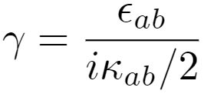
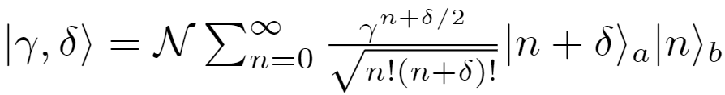
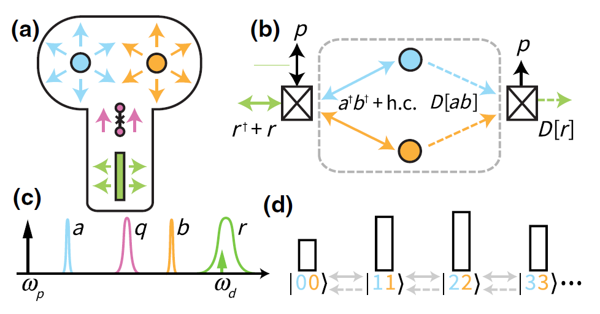

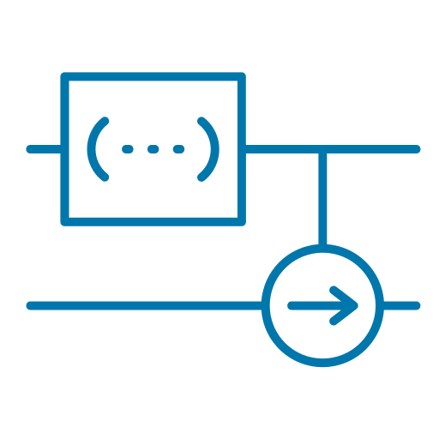

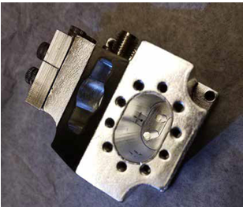
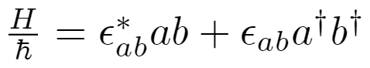
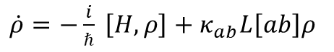
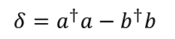
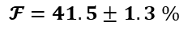
Pair Coherent States
Chen Wang Lab at
the University of Massachusetts-Amherst
Gertler et al., PRX 4, 020319 (2023)
$$δ=a^{†}a−b^{†}b$$
Improved Error Correction
- Pair cat codes detect and correct a broader range of errors than single cat codes. Robust to single photon loss
Enhanced Fault Tolerance
- Greater resistance to noise and correlated errors
- Reduced physical qubits for error corrected logical qubits
Increased Stability and Performance
- Better long-term coherence for quantum computing and communication
Experimental Fidelity:
$$𝓕=41.5±1.3 \%$$
$\dot{ρ}=−\frac{i}{ℏ} \left[H,ρ\right]+κ_{ab}L\left[ab\right]ρ$
7
Notes:
Robust to single photon loss.
Pair cat codes detect and correct a broader range of errors than single cat codes
Definition: A pair coherent state involves two modes with correlated amplitudes, often used in systems where both modes interact or are entangled, enhancing properties like error correction and fault tolerance.
Master Equation:
Formula: ρ˙=−iℏ[H,ρ]+κabL[ab]ρ
Explanation: Describes the time evolution of the density matrix ρ considering the Hamiltonian H and the dissipative process L[ab].
Hamiltonian:
Formula: H/h​=ϵab∗​ab+ϵab​a†b†
Explanation: Represents the interaction between two modes a and b in the system, creation and anhelation of ab modes.
Coupling Constant:
Formula:γ=iκab​/2ϵab​​
Explanation: Defines the coupling constant γ related to the interaction strength between the modes.
Improved Error Correction:
Explanation: Pair cat codes can detect and correct a broader range of errors compared to single cat codes.
Benefit: Enhances the reliability and accuracy of quantum operations.
Enhanced Fault Tolerance:
Explanation: Pair coherent states provide greater resistance to noise and correlated errors.
Benefit: Reduces the number of physical qubits needed for error-corrected logical qubits, making quantum systems more efficient.
Increased Stability and Performance:
Explanation: Pair coherent states offer better long-term coherence, crucial for stable quantum computing and communication.
Benefit: Improves overall performance and reliability of quantum systems.
Equations and Diagrams:
Coherent State Equation (Top Right):
Formula: ∣ψ⟩=∣alpha, β⟩
Explanation: Represents a coherent state as a superposition of Fock states.

Slide 8
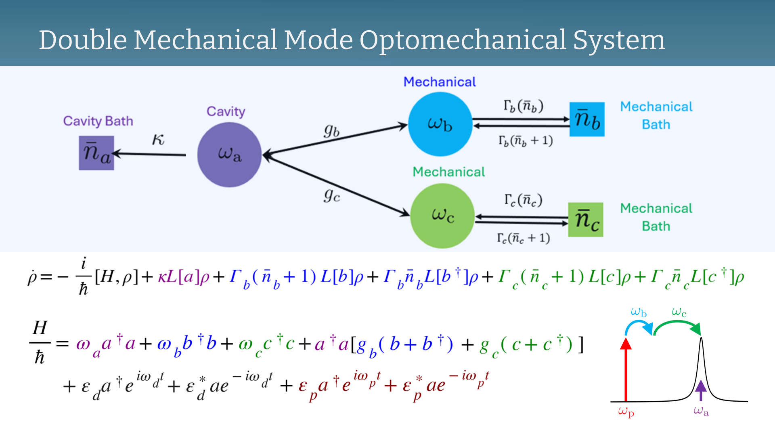

Slide 9
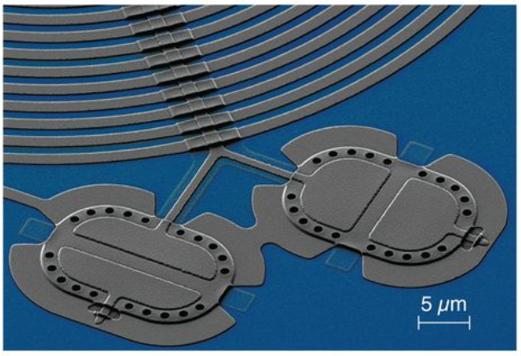
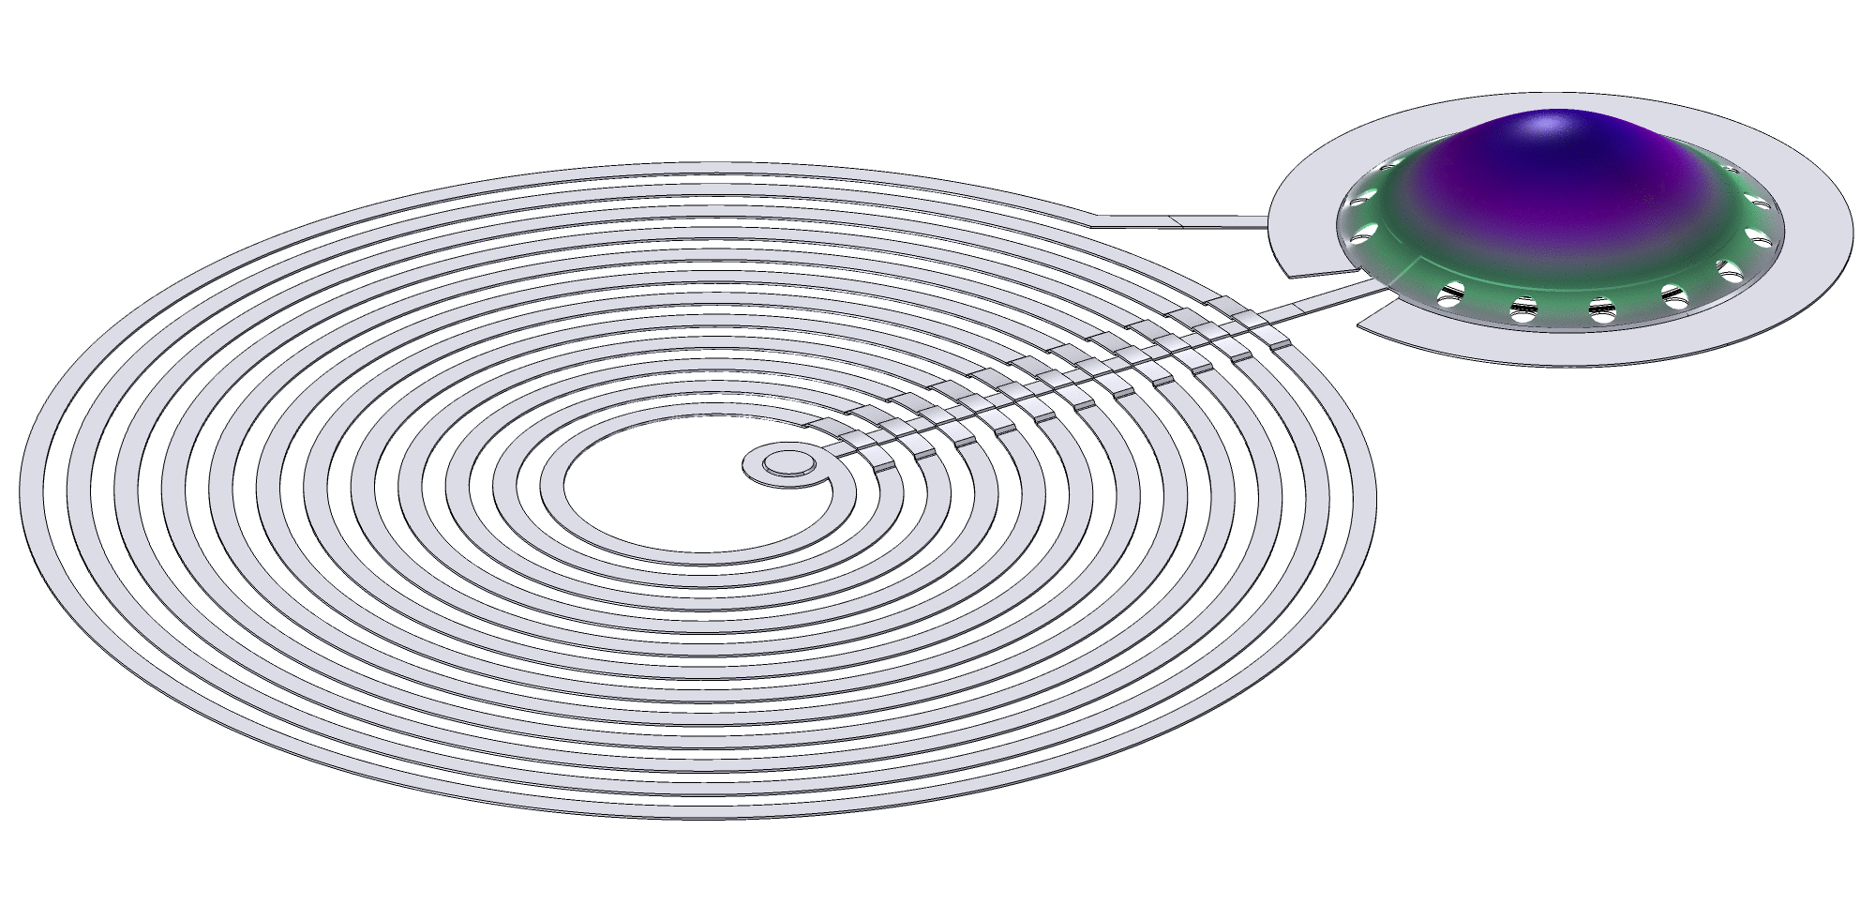
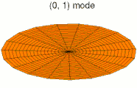
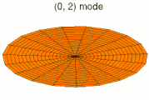
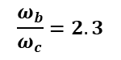
Experimental Realization
1: Two Mechanical Resonators
Vacuum Gap Capacitors of Two Types
Individual frequencies (more tunable) but share a single cavity mode
Coupling shared between mechanical modes
Can cause parasitic coupling
Kotler et al., Science 372, 622 (2021)
2: Two mechanical Modes of a Single Resonator
Teufel et al., Nature 475, 359 (2011)
More constrained in frequency for a given geometry
Choose this option with a constant circular membrane mode ratio
$$\frac{ω_{b}}{ω_{c}}=2.3$$
9
Notes:
LC resonator that forms a cavity mode, mechanical mode is resonator(s)
There may be many ways to physically realize these states in experiments
Two possible methods use vacuum gap capacitors
Of with Professor Hauer has worked on during his time at NIST
Can control interference through physical barriers or separating the mechanical modes option 1
Or induce two modes on a single resonator

Slide 10
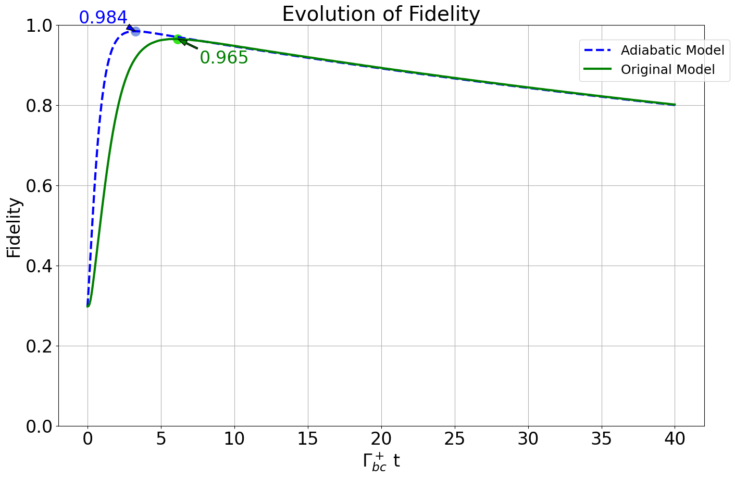
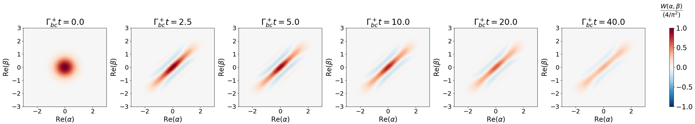
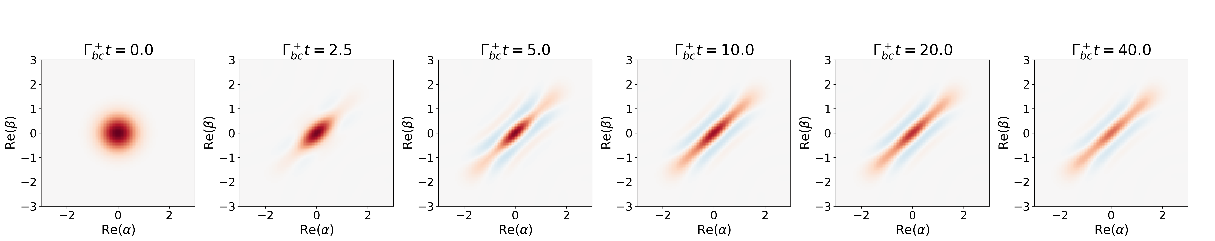
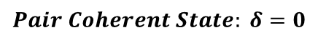
Simulation Fidelity
$$Pair Coherent State: δ=0$$
10
Notes:
Talk about simulating both Full and adiabatic model and comparing them
We expect to see results similar to Jeffery Gertler in Superconducting circuits realization of PCS
See joint wigner function plot
Expect to see high fidelity values for the steady state similar to this plot of PCS evolution of a simpler model
Evolving a ground state into the PCS and the occurring loss (decoherence)

Slide 11






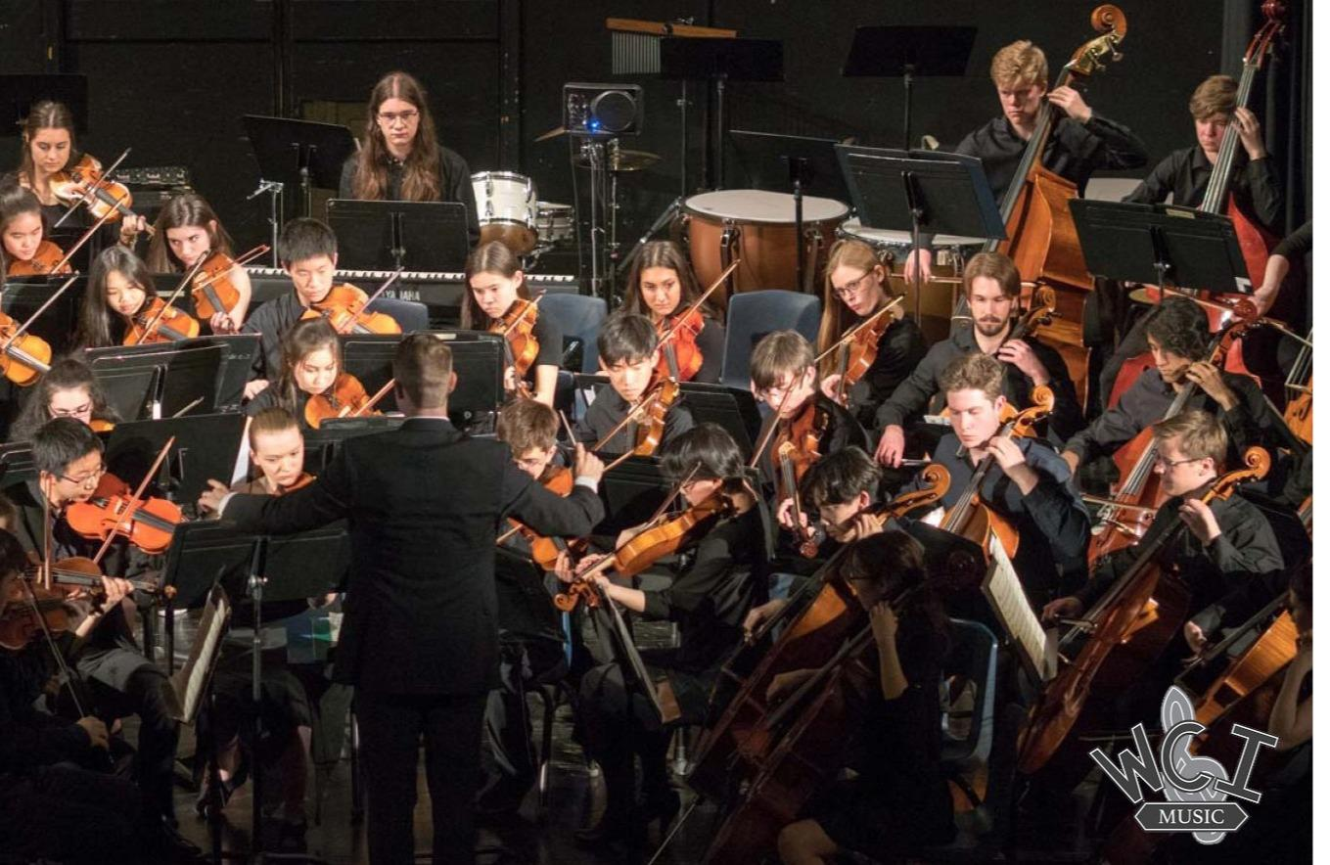
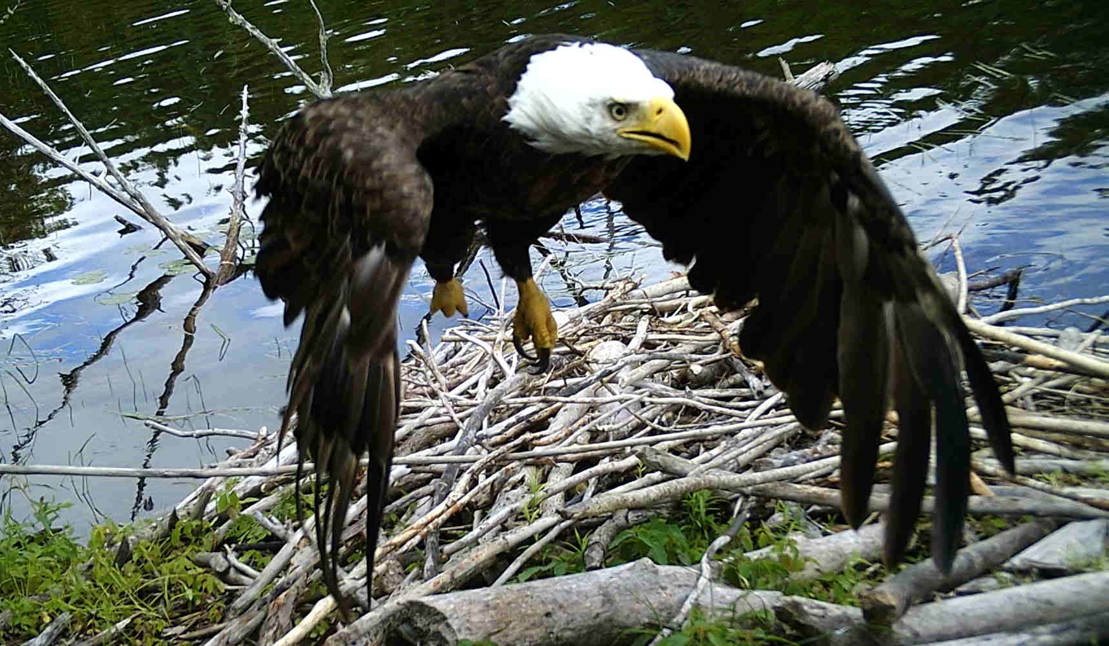
When Nathan isn't doing Physics, what is he up to?

